Slide 1
QF608: Research Methods for Quantitative Professionals
Jin, Kim, Quek, Wang and Woon (2019)

Slide 2
Research Hypothesis (Update)
The three stock-market factors suggested by Eugene F. Fama and Kenneth R. French in their 1993 paper titled “Common Risk Factors in the Returns on Stocks and Bonds” do not significantly explain the returns of stocks listed on the NYSE, NASDAQ and AMEX for the period between Jul 2011 – Dec 2018.

Slide 3
Data, Research Design & Findings

Slide 4
Data

Slide 5
Data Sources
Wharton Research Data Services (WRDS)
Center for Research in Security Prices (CRSP)
Compustat – Capital IQ
CRSP/Compustat Merged (CCM)

Slide 6
CRSP
Available Relevant Data (Monthly)
Closing Stock Price
Number of Shares Outstanding
Returns (Simple, Dividend, Delisting)
Identifiers
PERMCO
PERMNO
CUSIP – Not unique
Ticker – Not unique

Slide 7
Compustat – Capital IQ
Available Relevant Data (Balance Sheet, Annual)
Total Stockholders’ Equity
Deferred Taxes
Investment Tax Credit
Preferred Stock (Redemption, Liquidation, Carrying Values)
Identifiers
GVKEY
IID
CUSIP – Not unique
Ticker – Not unique, different from CRSP tickers

Slide 8
CRSP vs Compustat
Entity Level: PERMCO (CRSP) and GVKEY (Compustat) do not always agree, difficult to obtain perfect matching between datasets. As such, 1 PERMCO may correspond to multiple GVKEY and vice versa.
CRSP/Compustat Merged (CCM) tries to bridge the gap but some crucial data (e.g. number of shares outstanding) is missing/formatted in an inconvenient manner.
Solution: Use CCM to obtain entity level matching data, then raw data was obtained from standalone datasets. New identifier GVKEY PERMCO was created for purposes of traversing between datasets.
Example: If Apple Inc’s GVKEY is 1690 and its PERMCO is 7, its GV KEY PERMCO is 16907, which is a unique identifier.

Slide 9
Other Issues in Data
Missing Data – E.g. No returns data available when it should be
Incomplete Dataset – CRSP & Compustat do not cover the whole population of NYSE, NASDAQ and Amex traded stocks, only an overlap is available
Repeat Data – Double reporting of same company for same period
Conflicting Data – Standalone CRSP & Compustat vs. CCM
Computational Cost – Takes hours to compute several million cells

Slide 10
Research Design & Methodology

Slide 11
Size
Formulas
Size = Market Capitalisation of the Firm at June of time t
Market Capitalisation = Share Price x Number of Shares Outstanding
Small vs. Big
Every year, Sizes of firms traded on the NYSE, NASDAQ and Amex (where available) are computed.
Then, for only NYSE-traded firms, Size is ranked, then the median is used as the distinguisher between Small and Big companies.

Slide 12
Book-to-Market Equity
Formulas
Book-to-Market Equity= BE/ME
Book Common Equity (BE) = (Total Stockholders’ Equity + Deferred Taxes + Investment Tax Credit – Book Value of Preferred Stock) of the Firm at time t-1.
Book Value of Preferred Stock = Redemption, Liquidation or Carrying Value of Preferred Stock, in that order, when available.
Market Common Equity (ME) = Market Capitalisation of the Firm at December of time t-1.
High vs. Low
Every year, positive-only BE-ME for firms traded on the NYSE, NASDAQ and Amex (where available) are computed.
Then, for only NYSE-traded firms, BE-ME is ranked, then cut off points of 30% and 70% are used as distinguishers of Low, Medium and High firms.
Low = Bottom 30%, Medium = Next 40%, High = Top 30%

Slide 13
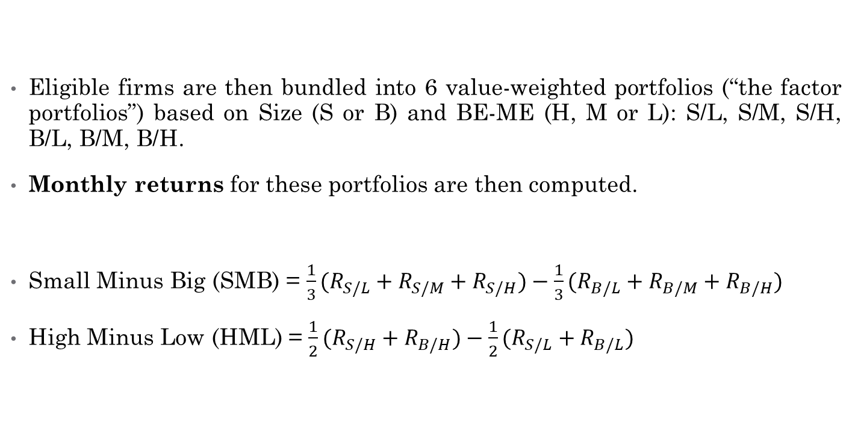
SMB & HML Factors
Eligible firms are then bundled into 6 value-weighted portfolios (“the factor portfolios”) based on Size (S or B) and BE-ME (H, M or L): S/L, S/M, S/H, B/L, B/M, B/H.
Monthly returns for these portfolios are then computed.
Small Minus Big (SMB) = $\frac{1}{3}(R_{S/L}+R_{S/M}+R_{S/H})−\frac{1}{3}(R_{B/L}+R_{B/M}+R_{B/H})$
High Minus Low (HML) = $\frac{1}{2}(R_{S/H}+R_{B/H})−\frac{1}{2}(R_{S/L}+R_{B/L})$

Slide 14
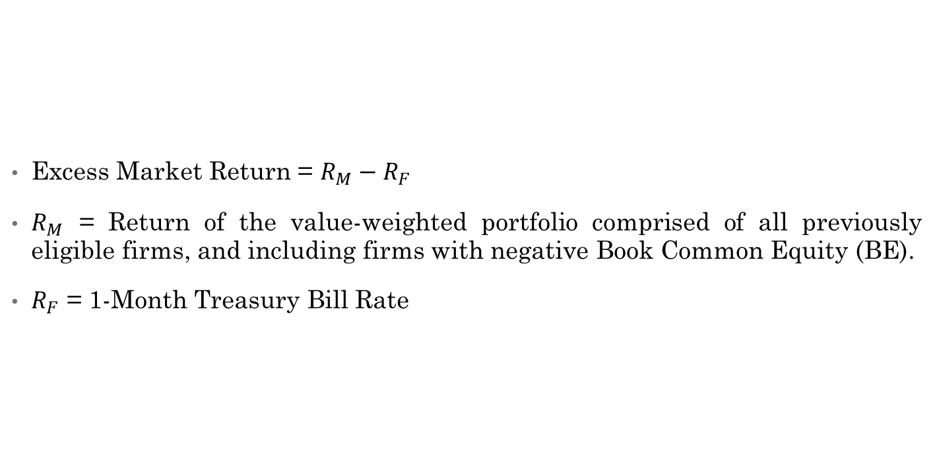
Excess Market Return Factor
Excess Market Return = $R_{M}−R_{F}$
$R_{M}$ = Return of the value-weighted portfolio comprised of all previously eligible firms, and including firms with negative Book Common Equity (BE).
$R_{F}$ = 1-Month Treasury Bill Rate

Slide 15
Quintile-Based Portfolios
The same firms eligible for the 6 factor portfolios are then bundled into 25 portfolios based on their Size and Book-to-Market Equity quintiles.
Again, NYSE-based breakpoints are used to distinguish the firms into their respective quintiles.
Monthly returns for these portfolios are then computed, and regressed against the three Fama-French factors introduced earlier.

Slide 16
Tests Performed & Initial Findings

Slide 17
Overview of tests performed
Summary statistics
Mean and standard deviation of excess returns
Correlations of 3 risk factors
Numbers of stocks per quintile
Regression Analysis
FF3 (2011-2018) vs FF3 (1963-1991)
FF3 (2011-2018) vs CAPM (2011-2018)

Slide 18

Ptf mean and std dev returns
Mean and standard deviation of excess returns

Slide 19
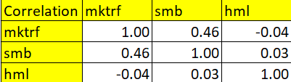
Correlation Matrix
Notes:
To explain no collinearity among risk factors

Slide 20
Portfolio size

Slide 21
FF3 Methodology
Coefficients of each factors can be expressed as such:
a – intercept (abnormal returns)
b – market excess returns
s – Size effect (Small Minus Big)
h – Book to equity value (High Minus Low)

Slide 22
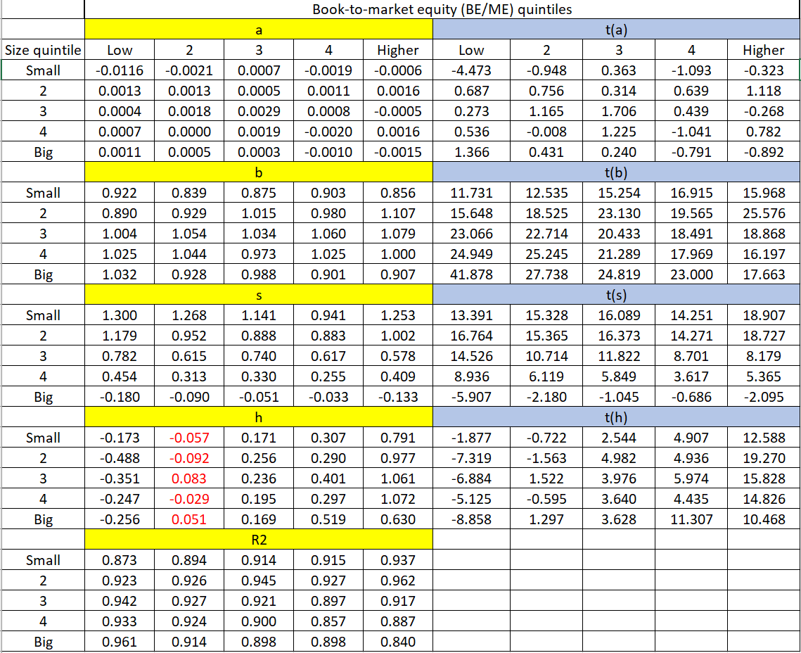
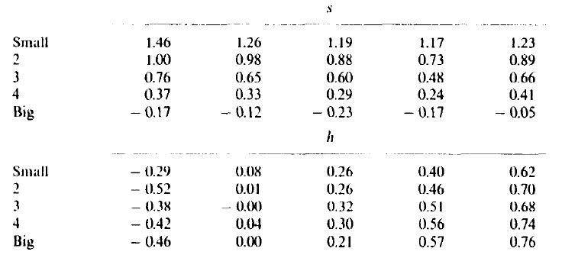
FF3 (2011-2018) vs FF3(1963-1991)
Intercept
For risk premium
SMB
HML

Slide 23
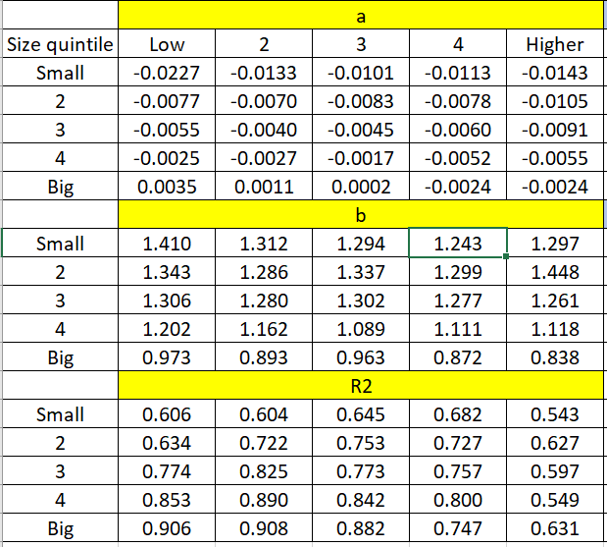
FF3 (2011-2018) vs CAPM (2011-2018)

Slide 24
Conclusion

Slide 25
Takeaways
Notes:
To prove fit of data for OLS

